Slide 1
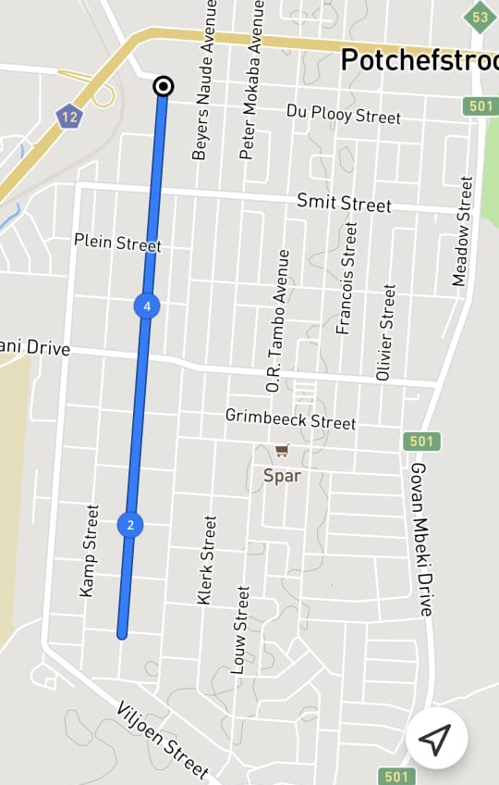
Supa Quick Night Race 5 km
Notes:
Kock Street (START) at Snowflake Down in Kock Street to Bloem Street and turn back in Kock Street (FINISH) at Snowflake

