Slide 1
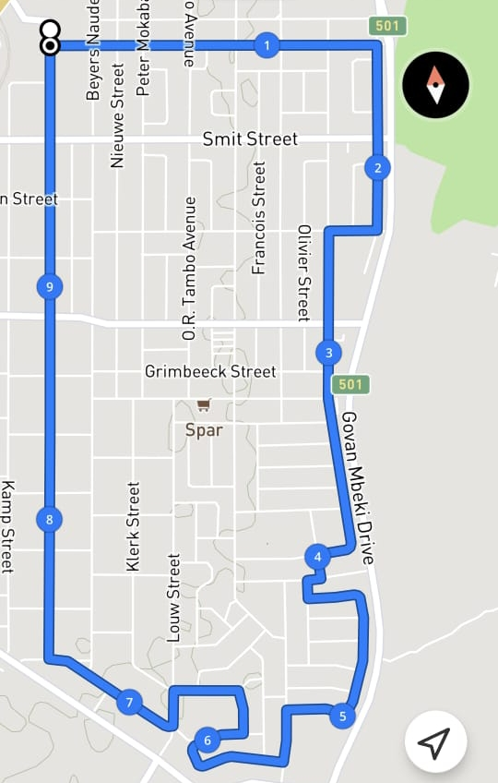
Supa Quick Night Race 10 km
Notes:
Kock Street (START) at Snowflake Du Plooy Street (turn left) continue to Meadow Street (turn right) continue to Jeugd Street (turn right) continue to Rivier Street (turn right) becomes Eland Street continue to Vygie Street (turn left) continue to Aarbei Avenue (turn right) continue to Tambotie Street (turn left) continue to Uitsig Street (turn left) becomes Gardenia Avenue continue to Suikerbossie Street (turn left) continue to Geelhout Avenue (turn right) continue to Palm Street (turn left) continue to Kiepersol Avenue (turn left) continue to Louw Street (turn left) continue to Paul Street (turn right) continue to Kock Street (turn right) continue to the (FINISH) at Snowflake

